Slide 1
AI-ENABLE WATER WELL PREDICTOR
CSE7101- Capstone Project
Review-2
Batch Number: 8
Under the Supervision of,
Dr./Mr./Ms./Prof. JAYAVADIVEL
Professor / Associate Professor / Assistant Professor
School of Computer Science and Engineering
Presidency University
Roll Number | Student Name
20221CSE0030 20221CSE0025 | J MONICA JASMINE VAIBHAVI NM
20221CSE0029 | HARSHITHA M
Name of the Program: BTECH CSE
Name of the HoD: Dr. Asif Mohammed and Dr . Blessed Prince
Name of the Program Project Coordinator: Refer- Annexure-1
Name of the School Project Coordinators: Dr. Sampath A K , Dr. Geetha A

Slide 2
Problem Statement Number: PSCS_8
Organization: Ministry of jal shakti
Category (Hardware / Software / Both) :Software
Problem Description :The project will likely involve analyzing geological and environmental data to predict optimal locations for drilling water wells, which addresses a common need for sustainable water resources.

Slide 3
Content
Abstract
Literature Survey
Objectives
Existing Methods and Drawbacks
Proposed Method & Feasibility Study
Modules
Hardware and Software Details
Timeline (Gantt Chart)
References

Slide 4
Paper | Research About | Study Area | Focus | Limitations / Gaps
Iqbal et al. (2021) | Groundwater level prediction using ensemble ML models and borehole data | Borehole datasets (Korea & Pakistan) | Improving drilling efficiency and sustainable water resource management | Focused mainly on borehole depth; limited inclusion of water quality aspects
Kisten et al. (2024) | Explainable AI model for predictive maintenance in smart agriculture | Smart agricultural facilities (South Africa) | Adding explainability to AI models for agriculture equipment maintenance | Not groundwater-specific; relevance is only in AI explainability
Agrawal et al. (2021) | AI techniques (SVM, Naïve Bayes, PSO) for groundwater quality assessment | Pindrawan tank area, Chhattisgarh, India | Predicting Water Quality Index (WQI) quickly and accurately | Tested only in one area; scalability and generalization uncertain
Rammohan et al. (2024) | Groundwater quality prediction using ML + GIS integration | Kanchipuram district, Tamil Nadu, India | Classifying and predicting water quality with spatial visualization | Region-specific; needs large datasets and strong GIS support
Kumar & Bhattacharjya (2021) | GRNN models with GRACE satellite + rainfall/temperature for groundwater fluctuation | Uttarakhand, India | Predicting groundwater fluctuation where borehole data is limited | Dependent on satellite data; accuracy limited in sparse-data regions
Supreetha et al. (2022) | Hybrid LSTM + Lion Algorithm for groundwater level forecasting | Udupi district, Karnataka, India | Enhancing accuracy of time-series groundwater forecasting | Tested only in one district; computationally heavy for large datasets

Slide 5
Abstract :
Groundwater is vital for domestic, agricultural, and industrial use but is threatened by overexploitation, climate change, and contamination.
Traditional well prediction methods rely on limited borehole data and manual analysis, leading to inefficiency and inaccuracy.
The proposed project develops an AI-enabled Water Well Predictor, a software-based system for groundwater level forecasting and well suitability assessment.
It leverages machine learning and deep learning models such as ensemble learning, SVM, neural networks, and hybrid LSTM-based methods.
Time-series borehole data, hydrological patterns, and rainfall information are used to predict groundwater fluctuations and drilling depth.
Geospatial and correlation-based mechanisms enhance predictions, even in areas with limited borehole records.
The system also evaluates water quality indices using AI-driven models, enabling safe and sustainable groundwater usage.
Validation on real-world datasets shows high prediction accuracy, outperforming traditional statistical methods.
The software supports cost reduction, efficiency improvement, and sustainable groundwater management for irrigation, urban supply, and environmental planning.

Slide 6
Literature Survey (Overview) :
Machine Learning for Groundwater Levels:
Researchers used ensemble models (XGBoost, Random Forest, etc.) to predict groundwater levels from borehole data, improving drilling efficiency.
AI for Water Quality:
Studies applied SVM, Naïve Bayes, and optimization algorithms to calculate the Water Quality Index (WQI) with high accuracy, saving time compared to manual methods.
GIS and AI Integration:
AI models combined with Geographical Information Systems (GIS) helped predict and visualize groundwater quality, useful for selecting well locations.
Neural Networks for Fluctuation:
GRNN models with satellite, rainfall, and temperature data predicted groundwater levels even where borehole data is limited.
Deep Learning Forecasting:
Hybrid LSTM models gave better accuracy in forecasting groundwater levels compared to traditional methods.
Explainable AI in Agriculture:
Work on XAI (Explainable AI) in smart farming shows the importance of making AI models transparent and user-friendly

Slide 7
Objectives
To predict groundwater levels using AI-based models.
To assess water well suitability and drilling depth for efficient extraction.
To evaluate groundwater quality through AI-driven Water Quality Index prediction.
To integrate geospatial analysis for better visualization and well location planning.
To support sustainable groundwater management with accurate and user-friendly software.

Slide 8
Existing Methods & Drawbacks (Elaborated) :
1) Traditional Hydrogeological Surveys
Method: Groundwater levels and well suitability are estimated through manual borehole drilling, soil/rock analysis, and field surveys.
Drawbacks:
  Time-consuming and costly.
  Limited coverage, as surveys cannot be conducted everywhere.
  Inaccurate in dynamic conditions (e.g., climate change, seasonal variations).
2) Statistical and Mathematical Models
Method: Regression equations and time-series models are used to predict groundwater fluctuations.
Drawbacks:
  Work well only with large, clean datasets.
  Poor handling of non-linear and complex groundwater patterns.
  Lack adaptability to changing environmental conditions.
3) Water Quality Index (WQI) Manual Calculations
Method: WQI is derived by measuring multiple chemical and physical water parameters in the lab and combining them into an index.
Drawbacks:
  Lengthy and error-prone calculation process.
  Requires large datasets and laboratory testing.

Slide 9
Existing Methods & Drawbacks (Elaborated) :
4) Machine Learning with Limited Scope
Method: Use of single ML algorithms like SVM, Naïve Bayes, or ANN for groundwater prediction.
Drawbacks:
  Accuracy depends heavily on the quality of input data.
  Models often overfit and fail in unseen regions.
  Cannot handle missing or sparse borehole data effectively.
5) GIS-Only Mapping Approaches
Method: Geographical Information Systems (GIS) used for spatial mapping of groundwater resources.
Drawbacks:
  Good for visualization, but not predictive on their own.
  Lack integration with AI models for forecasting.

Slide 10
Proposed Method
Data Collection – Gather borehole, rainfall, soil, and water quality data.
Preprocessing – Clean and organize the data for analysis.
AI Models – Use ML/DL models (Ensemble, LSTM, GRNN) to predict:
Groundwater level
Drilling depth
Water Quality Index (WQI)
GIS Integration – Map results to show safe zones for well drilling.
Software Tool – Build a simple interface to display predictions and recommendations.
Validation – Test predictions with real-world data for accuracy.

Slide 11
Feasibility Study
. Technical Feasibility
  AI models (ML/DL) and GIS tools are readily available.
  Software can be built using Python, TensorFlow, and open-source libraries.
Economic Feasibility
  Cost is low since most tools and datasets are open-source.
  Saves money compared to manual surveys and drilling trials.
Operational Feasibility
  User-friendly software interface makes it easy for farmers, planners, and authorities.
  Provides quick predictions and recommendations for decision-making.
Social & Environmental Feasibility
  Helps ensure safe drinking water and sustainable groundwater use.
  Reduces over-extraction and supports community water planning.

Slide 12
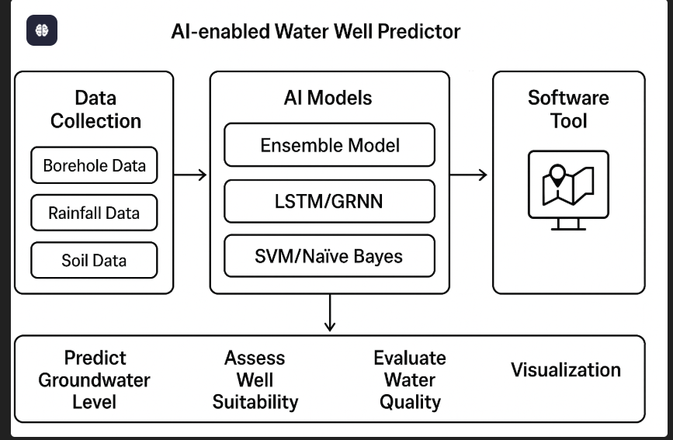
architecture Diagram & Explanation

Slide 13
architecture Diagram & Explanation
Data Collection – The system collects borehole, rainfall, and soil data.
AI Models – Different AI techniques are used:
Ensemble models → predict groundwater level.
LSTM/GRNN → forecast fluctuations.
SVM/Naïve Bayes → check water quality.
Software Tool – All results are shown in a simple software interface with maps and graphs.
Outputs – The system helps to:
Predict groundwater level.
Suggest suitable drilling depth.
Check water quality.
Visualize results for easy decision-making.

Slide 14
Modules :
Data Collection Module
Collects borehole, rainfall, soil, and water quality data.
Preprocessing Module
Cleans and organizes data, handles missing values.
Groundwater Prediction Module
Uses AI models (Ensemble, LSTM, GRNN) to forecast groundwater levels and fluctuations.
Water Quality Analysis Module
Predicts Water Quality Index (WQI) using ML algorithms.
GIS & Visualization Module
Maps results and shows safe drilling zones.
User Interface Module
Provides easy access to predictions, reports, and recommendations for users.

Slide 15
Technology Stack(Hardware and Software Details) :
Software Requirements
Programming Language: Python (primary for AI/ML models)
Frameworks & Libraries:
  TensorFlow / Keras – for Deep Learning (LSTM, GRNN)
  Scikit-learn – for Machine Learning (SVM, Random Forest, Naïve Bayes, XGBoost)
  Pandas & NumPy – for data handling and preprocessing
  Matplotlib / Seaborn – for visualization
  GIS Libraries (e.g., QGIS, GeoPandas, Folium) – for mapping
Database: MySQL / SQLite (to store borehole, rainfall, and water quality data)
Frontend (Optional): HTML, CSS, JavaScript (for web interface)
Backend (Optional): Flask / Django (to connect AI models with the UI)
IDE/Tools: Jupyter Notebook / PyCharm / VS Code

Slide 16
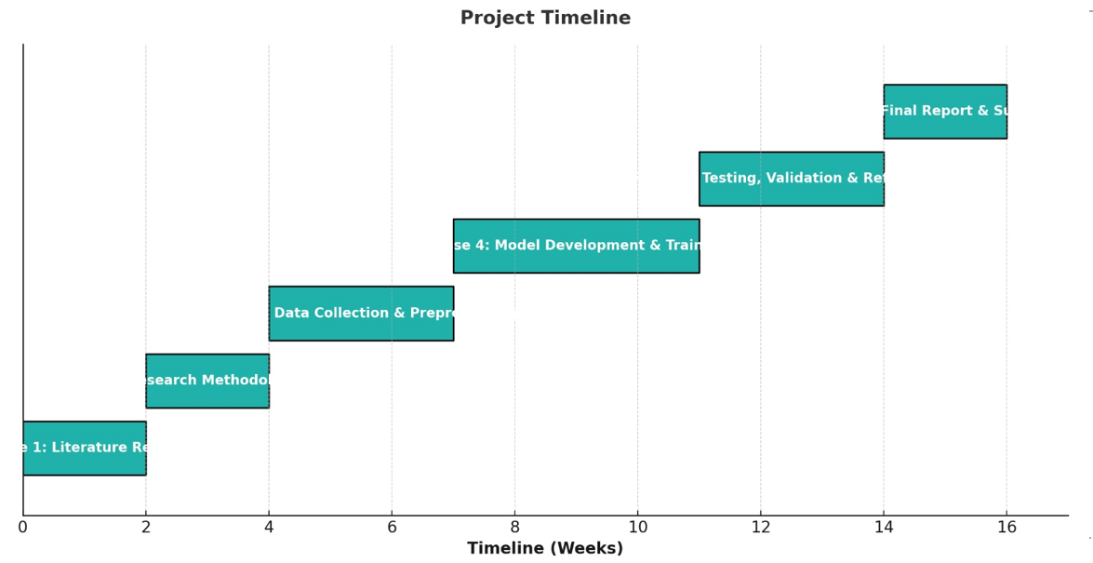
Timeline of the Project (Gantt Chart)

Slide 17
References (IEEE Paper format)
[1] N. Iqbal, A.-N. Khan, A. Rizwan, R. Ahmad, B. W. Kim, K. Kim, and D.-H. Kim,
“Groundwater Level Prediction Model Using Correlation and Difference Mechanisms Based on Boreholes Data for Sustainable Hydraulic Resource Management,”
IEEE Access, vol. 9, pp. 96092–96112, Jul. 2021, doi: 10.1109/ACCESS.2021.3094735.
[2] M. Kisten, A. E.-S. Ezugwu, and M. O. Olusanya,
“Explainable Artificial Intelligence Model for Predictive Maintenance in Smart Agricultural Facilities,”
IEEE Access, vol. 12, pp. 24348–24364, Feb. 2024, doi: 10.1109/ACCESS.2024.3365586.
[3] P. Agrawal, A. Sinha, S. Kumar, A. Agarwal, A. Banerjee, V. G. K. Villuri, C. S. R. Annavarapu, R. Dwivedi, V. V. R. Dera, J. Sinha, and S. Pasupuleti,
“Exploring Artificial Intelligence Techniques for Groundwater Quality Assessment,”
Water, vol. 13, no. 9, p. 1172, Apr. 2021, doi: 10.3390/w13091172.
[4] B. Rammohan, P. Partheeban, R. Ranganathan, and S. Balaraman,
“Groundwater Quality Prediction and Analysis Using Machine Learning Models and Geospatial Technology,”
Sustainability, vol. 16, no. 22, p. 9848, Nov. 2024, doi: 10.3390/su16229848.
[5] D. Kumar and R. K. Bhattacharjya,
“GRNN Model for Prediction of Groundwater Fluctuation in the State of Uttarakhand of India Using GRACE Data Under Limited Bore Well Data,”
Journal of Hydroinformatics, vol. 23, no. 3, pp. 567–582, Mar. 2021, doi: 10.2166/hydro.2021.108.
[6] S. B. Supreetha, N. Shenoy, and P. Nayak,
“Lion Algorithm-Optimized Long Short-Term Memory Network for Groundwater Level Forecasting in Udupi District, India,”
Applied Computational Intelligence and Soft Computing, vol. 2022, pp. 1–13, 2022, doi: 10.1155/2022/xxxxxx

Slide 18


